Slide 1
TensorFlow Introduction
Instructor: Kevin Liang

Slide 2

Why TensorFlow?

Slide 3
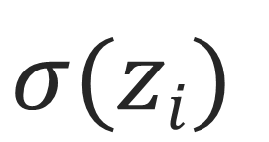
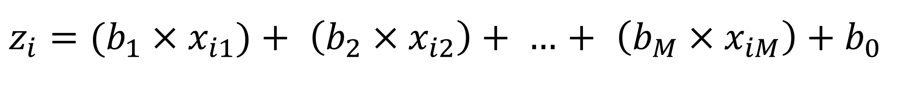
\
$$σ(zi)$$
A Simple
Neural Network
$z_{i}=(b_{1}×x_{i1})+$ $\left(b_{2}×x_{i2}\right)+ …$ $+$ $\left(b_{M}×x_{iM}\right)+b_{0}$
z_{i}
b_{M}
b₁
x_{i1}
x_{i2}
x_{iM}
features of data

Slide 4

\
Fast to develop in, simple syntax
Easy to read
Lots of third party modules and support libraries
Large community
Open source, free
Python

Slide 5
\
Why Not Deep Learning with Python?

Slide 6
Python is dynamically typed
Why Not Deep Learning with Python?
x + y
x | y
1 | 2
0.37 | 0.94
1 | 0.15
[2, 4] | [1]
“Hello” | “World”
Runtime type checking
Neural networks require a very large number of numerical operations

Slide 7
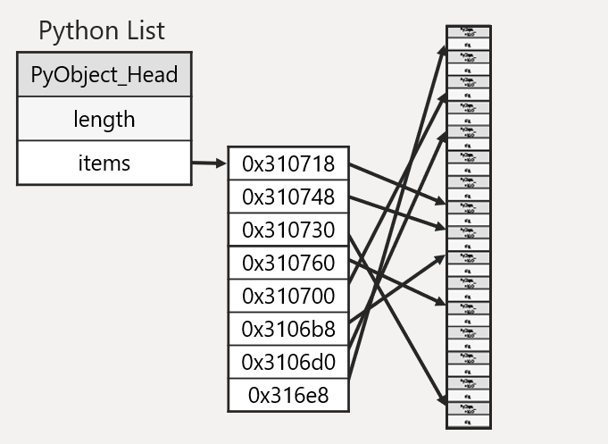
\
Python lists
Why Not Deep Learning with Python?
Neural networks are built on linear algebra operations
Memory placement of elements can be scattered
Ability to perform various array operations can be wanting

Slide 8

\
What About NumPy?

Slide 9
\
Popular Python package for numerical computation in Python
What About NumPy?

Slide 10
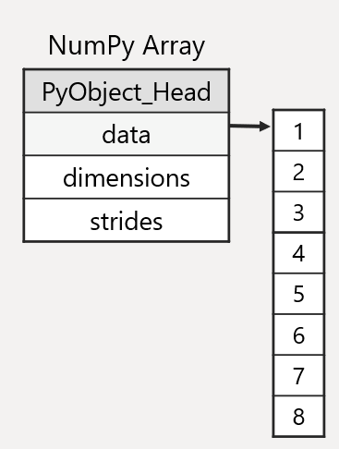
\
Popular Python package for numerical computation in Python
Introduces numpy.array for multidimensional numerical array support, as well as many common numerical operations
ex:
- array/matrix arithmetic
- broadcasting
- zeros, ones
- logic, masking
- saving to/loading from files
What About NumPy?

Slide 11
\
Popular Python package for numerical computation in Python
Introduces numpy.array for multidimensional numerical array support, as well as many common numerical operations
ex:
- array/matrix arithmetic
- broadcasting
- zeros, ones
- logic, masking
- saving to/loading from files
Written in C and Python to make common computations fast
What About NumPy?

Slide 12
\
$$σ(zi)$$
A Simple
Neural Network
$z_{i}=(b_{1}×x_{i1})+$ $\left(b_{2}×x_{i2}\right)+ …$ $+$ $\left(b_{M}×x_{iM}\right)+b_{0}$
z_{i}
b_{M}
b₁
x_{i1}
x_{i2}
x_{iM}
features of data

Slide 13
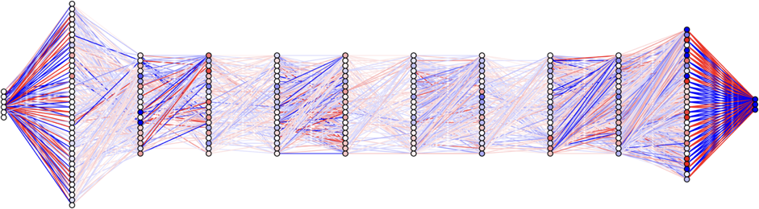
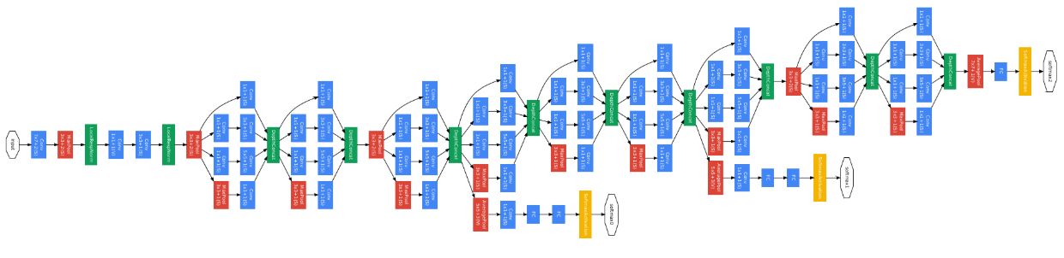
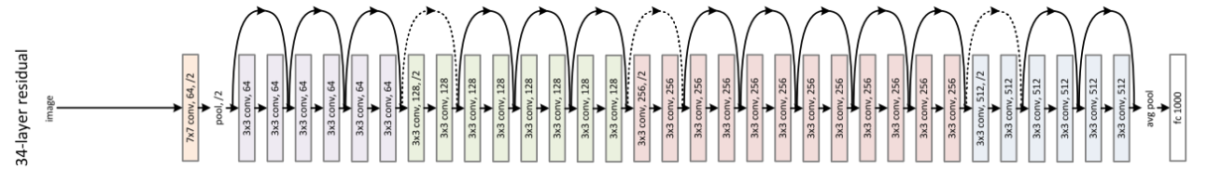

Slide 14
\
Disadvantages of NumPy
Disadvantages of NumPy
Compositions of many NumPy requires going through the Python interpreter
x

Slide 15
\
Disadvantages of NumPy
Disadvantages of NumPy
Compositions of many NumPy requires going through the Python interpreter
x
Can’t do automatic differentiation, past computations aren’t “remembered”
x

Slide 16
\
Disadvantages of NumPy
Disadvantages of NumPy
Compositions of many NumPy requires going through the Python interpreter
x
Can’t do automatic differentiation, past computations aren’t “remembered”
x
Doesn’t include some operations common in deep learning (i.e. batched matrix multiply/convolution, sigmoid nonlinearity, pooling, etc.)
x

Slide 17
Computation Graphs
y
m
ℓ = [y – (mx+b)]²
*
x
+
–
sqr
b

Slide 18
Open Source
Research & Production
Hardware & Software
API’s
CPU
GPU(s)
TPU(s)
Ubuntu
Windows
Mac OSX
iOS
Android
Raspberry Pi
Python
C++
Java
Go

Slide 19







Slide 20
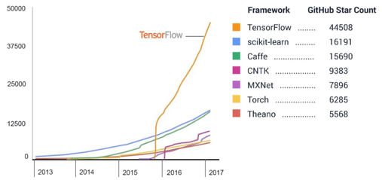
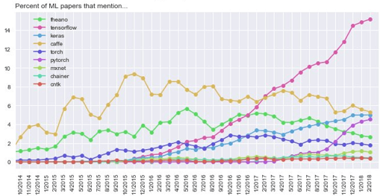

Slide 21

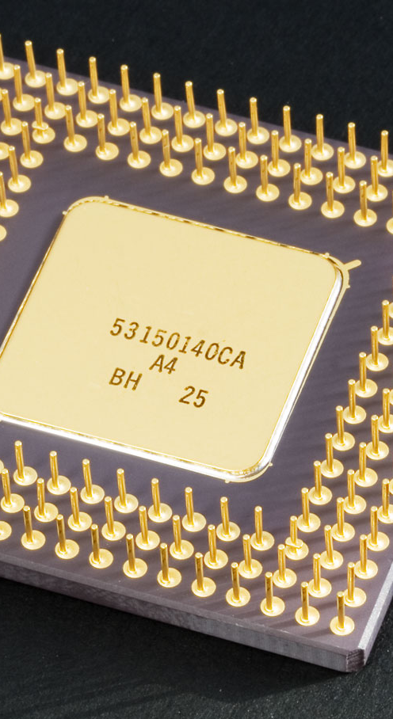




GPU
iOS
Raspberry Pi
CPU
TPU
Android

Slide 22


Slide 23
TensorFlow Terminology

Slide 24
\
Mathematical definition: Geometric objects defining linear relations
TensorFlow:
Tensors
Generalization of vectors and matrices
0th Order:
Scalar
1st Order:
Vector
2nd Order:
Matrix
4
2
9
5
1
9
2
2
0
8

Slide 25
\
TensorFlow Definition: Unit for data and variables
TensorFlow:
Tensors
0th Order:
scalar_node = tf.constant(8.0, dtype=tf.float32)
4th Order:
weights = tf.Variable(tf.random_normal([3, 3, 256, 512]), name=“conv_weights”)

Slide 26
Typical computational program operates directly on the data
TensorFlow:
Data Flow
Graphs
2
import numpy
x = [-2,–1, 0, 1, 2]
y = [–5, 1, 2, –1, –6]
p = numpy.polyfit (x, y, deg=2)
0
–2
–4
y_hat = p[0]*x**2 + p[1]*8 + p[2]
–6
–8
–10
–12
–14
–16
Operation definition and execution
happen at every line of code
(imperative programming)
–18
*
–3
–2
–1
0
1
2
3

Slide 27
tf.graph
TensorFlow:
Data Flow
Graphs
const0
Add
const1
holds the operations of the computation graph
default graph created silently after import tensorflow

Slide 28
\
TensorFlow: 2 Steps
TensorFlow:
Data Flow
Graphs
const0
Add
const1
Define computation statically as a graph:
a = tf.constant(3.0, dtype=tf.float32)
b = tf.constant(4.0, dtype=tf.float32)
sum_a_b = tf.add(a, b)
This is deferred computation,
or symbolic programming
*
TensorFlow’s new eager mode
was designed to make TensorFlow
more imperative and Pythonic
*
Execute the graph with a tf.session to get outputs:
sess = tf.Session()
print(sess.run(sum_a_b))# Prints “7.0” to screen
sess.close()

Slide 29
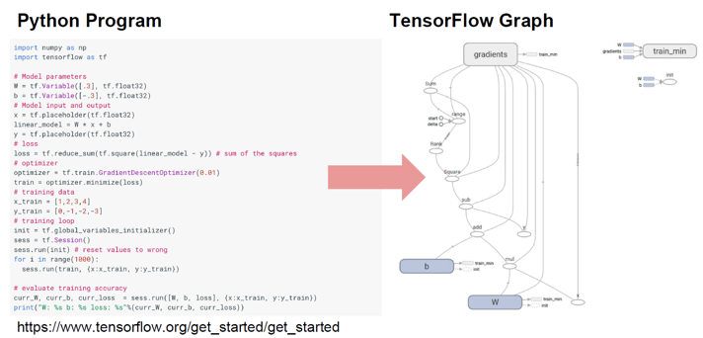
TensorFlow:
Data Flow
Graphs

Slide 30
Tensors + Data Flow Graphs

